Slide 1



Exhaustive Analysis of Indian Agriculture using Power BI
-Shwetha Poojary

Slide 2

Learning Objectives
Describe the business value and features of Power BI.
Compare and contrast the different components that make up Power BI.
Describe how to clean and transform data.
Examine how AI insights help detect anomalies and spot trends.
Build a basic dashboard.
Consume Power BI reports and dashboards
GOAL
Source :
https://learn.microsoft.com/en-us/training/modules/introduction-power-bi/

Slide 3
Tools and Technology used
1.Power BI desktop:
Data import, modelling, visualization and dashboard creation.
2.Power Query Editor:
Data extraction, cleaning, transformation, merging.
3.Power BI visuals:
Bar charts, line charts, maps ,cards and slicers.

Slide 4
Methodology
Power BI Fundamentals:
Data Importing : Load cleaned datasets into Power BI from Excel, SQL,CSV etc.
Data Modeling : Define relationships between tables (if multiple datasets exist).
2. DAX (Data Analysis Expressions) : Learn basic DAX functions
SUM() – Total production, yield, or revenue.
AVERAGE() – Average yield per crop or state.
FILTER() & CALCULATE() – Apply conditional calculations.
3.Visualization Tools : Understand when to use bar charts, line graphs, maps, and tables for agricultural insights.

Slide 5
Problem Statement:
Exhaustive Analysis of Indian Agriculture Sector Using Power BI
The agricultural sector in India faces challenges in optimizing crop production and understanding regional variations. This project aims to use Power BI to analyze agricultural data, focusing on state-wise and district-wise crop performance, seasonal trends, and yearly production patterns. The goal is to identify key insights like crop yield (production per unit area) and highlight variations across different regions and seasons. By visualizing these metrics, the project will support better decision-making and help improve agricultural planning and productivity.
The Questions that I have chosen to solve are :
1.From the given data set remove the unwanted data.
2.Find the total count of crops using cards.
3.Find the productions of each state using any charts.
4.Find the productions of each crop.
5.Find the sum of productions by crop year using tree map.
6.Find the sum of productions per season.

Slide 6
7.Using line chart find the sum of productions per year.
8.Analyse sum of area by state using tree map.
9.Using pie chart find the count of crop of each state.
10.Using area chart analyze count of crop name by crop year.
11.Using donut chart analyze count of crop name by season.
12.Analyze sum of productions by crop name using tree map.
13.Analyze the data using table visual.
14.Find the sum of productions by crop name and crop year using any BI visual.
15.Make a interactive dashboard.

Slide 7
Solution:
Data Import and Cleaning: Import the dataset into Power BI, clean it by fixing any errors and ensuring correct data types for each column.
Data Modeling: Set up relationships between the fields and create calculated metrics like crop yield (production per area).
Interactive Dashboards : Build dashboards with maps, bar charts, and line charts to display crop production, seasonal trends, and state/district comparisons.
Filters and Slicers :Add filters for state, district, crop, season, and year to let users drill down into specific details.
Insights and Analysis : Use Power BI’s DAX functions to create KPIs like average yield, growth over time, and trends in crop production.

Slide 8
Solutions for the problems given above:
1.From the given data set remove the unwanted data:
From the given dataset of Exhaustive analysis of Indian agriculture sector by using transform data panel that will redirect you to a power query editor where you can delete the columns which doesn’t have any value by right clicking on the column and there you can find the option remove column by clicking that easily you can delete the column also you can change the datatype also then click the close and apply.
2.Find the total count of crops using cards:
Firstly choose the card visual from the visualization pane and then drag and drop the crops to the value and there select the count(distinct).
3.Find the productions of each state using any charts:
Select bar chart from the visual pane and drag the state name to y-axis and productions to x-axis.
4.Find the productions of each crop:
Select any bar chart and drag sum of productions to y-axis and crop name to x-axis.

Slide 9
5.Find the sum of productions by crop year using tree map:
Here first select the tree map and then to category drag and drop the crop year and to the value sum of productions.
6.Find the sum of productions per season:
Select column chart from the visual pane and drag and drop the productions to y-axis and seasons to x-axis.
7.Using line chart find the sum of productions per year:
Select line chart and drag and drop the productions to y-axis and year to x-axis.
8.Analyse sum of area by state using tree map:
Here first select the tree map and then to category drag and drop the state name and to the value sum of area.
9.Using pie chart find the count of crop of each state:
Select pie chart and drag and drop count of crop and state to it.

Slide 10
10.Using area chart analyze count of crop name by crop year:
Select area chart and drag and drop count of crop to y-axis and crop year to x-axis.
11.Using donut chart analyze count of crop name by season:
Select donut chart and drag and drop the crop name and season to it.
12.Analyze sum of productions by crop name using tree map:
Here first select the tree map and then to category drag and drop the crop name and to the value sum of productions.
13.Analyze the data using table visual:
select table visual and drag and drop the state name, crop name and production.
14.Find the sum of productions by crop name and crop year using any BI visual:
Select any two bar visuals and drag and drop production to y-axis and crop name and year to x-axis.
15.Make a interactive dashboard:
Get all the data together and arrange that in the single dashboard.

Slide 11
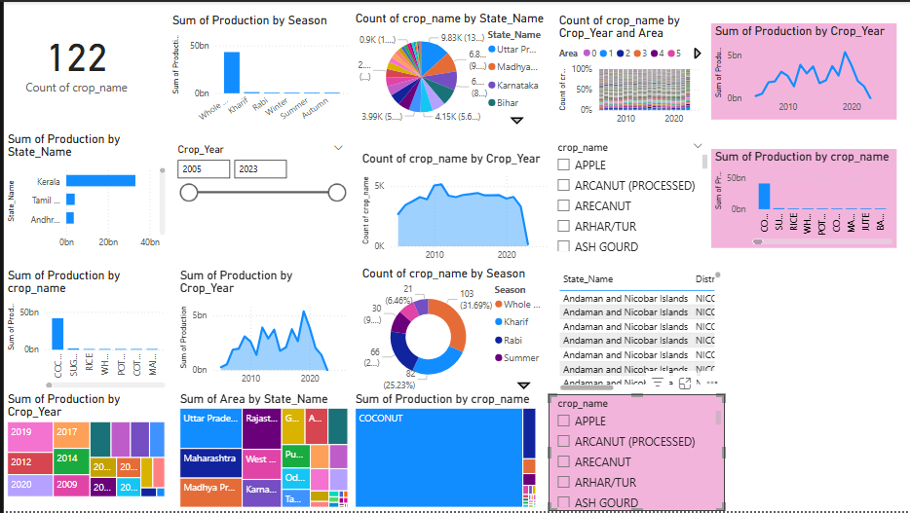
Screenshot of Output:

Slide 12
Conclusion:
The analysis of Indian agriculture using Power BI provides valuable insights into crop production across different states and seasons. By visualizing the sum of production by season, it becomes clear which seasons are most productive for various crops. The sum of production by state highlights regional differences, helping to identify high-performing states and regions that may require more support or resources. Additionally, the count of crop names provides an understanding of the variety of crops grown in each region and their seasonal patterns. Overall, this Power BI analysis helps to optimize crop planning, improve decision-making, and identify trends that can drive better agricultural policies and strategies.

